Slide 1
SSL/TLS
CS 361S
Vitaly Shmatikov
slide <number>

Slide 2
Reading Assignment
Kaufman. Chapters 15.1-7 and 19.
slide <number>

Slide 3
What Is SSL / TLS?
Secure Sockets Layer and
Transport Layer Security protocols
  Same protocol design, different crypto algorithms
De facto standard for Internet security
  “The primary goal of the TLS protocol is to provide privacy and data integrity between two communicating applications”
Deployed in every Web browser; also VoIP, payment systems, distributed systems, etc.
slide <number>

Slide 4
SSL / TLS Guarantees
End-to-end secure communications in the presence of a network attacker
  Attacker completely 0wns the network: controls Wi-Fi, DNS, routers, his own websites, can listen to any packet, modify packets in transit, inject his own packets into the network
Scenario: you are reading your email from an Internet café connected via a r00ted Wi-Fi access point to a dodgy ISP in a hostile authoritarian country
slide <number>

Slide 5
History of the Protocol
SSL 1.0 – internal Netscape design, early 1994?
  Lost in the mists of time
SSL 2.0 – Netscape, Nov 1994
  Several weaknesses
SSL 3.0 – Netscape and Paul Kocher, Nov 1996
TLS 1.0 – Internet standard, Jan 1999
  Based on SSL 3.0, but not interoperable (uses different cryptographic algorithms)
TLS 1.1 – Apr 2006
TLS 1.2 – Aug 2008
slide <number>

Slide 6
SSL Basics
SSL consists of two protocols
Handshake protocol
  Uses public-key cryptography to establish several shared secret keys between the client and the server
Record protocol
  Uses the secret keys established in the handshake protocol to protect confidentiality, integrity, and authenticity of data exchange between the client and the server
slide <number>

Slide 7
SSL Handshake Protocol
Runs between a client and a server
  For example, client = Web browser, server = website
Negotiate version of the protocol and the set of cryptographic algorithms to be used
  Interoperability between different implementations
Authenticate server and client (optional)
  Use digital certificates to learn each other’s public keys and verify each other’s identity
  Often only the server is authenticated
Use public keys to establish a shared secret
slide <number>

Slide 8
Handshake Protocol Structure
ClientHello
S
C
ServerHello,
[Certificate],
[ServerKeyExchange],
[CertificateRequest],
ServerHelloDone
[Certificate],
ClientKeyExchange,
[CertificateVerify]
Finished
switch to negotiated cipher
switch to negotiated cipher
Record of all sent and
received handshake messages
Finished
slide <number>

Slide 9
ClientHello
ClientHello
S
C
Client announces (in plaintext):
Protocol version he is running
Cryptographic algorithms he supports
Fresh, random number
slide <number>

Slide 10
ClientHello (RFC)
struct {
ProtocolVersion client_version;
Random random;
SessionID session_id;
CipherSuite cipher_suites;
CompressionMethod compression_methods;
} ClientHello
Highest version of the protocol supported by the client
Session id (if the client wants to resume an old session)
Set of cryptographic algorithms supported by the client (e.g., RSA or Diffie-Hellman)
slide <number>

Slide 11
ServerHello
C, version_{c}, suites_{c}, N_{c}
S
C
ServerHello
Server responds (in plaintext) with:
Highest protocol version supported by
both the client and the server
Strongest cryptographic suite selected
from those offered by the client
Fresh, random number
slide <number>

Slide 12
ServerKeyExchange
C, version_{c}, suites_{c}, N_{c}
S
C
version_{s}, suite_{s}, N_{s},
ServerKeyExchange
Server sends his public-key certificate
containing either his RSA, or
his Diffie-Hellman public key
(depending on chosen crypto suite)
slide <number>

Slide 13
ClientKeyExchange
C, version_{c}, suites_{c}, N_{c}
S
C
version_{s}, suite_{s}, N_{s},
certificate,
“ServerHelloDone”
ClientKeyExchange
The client generates secret key material
and sends it to the server encrypted with
the server’s public key (if using RSA)
slide <number>

Slide 14
ClientKeyExchange (RFC)
struct {
select (KeyExchangeAlgorithm) {
case rsa: EncryptedPreMasterSecret;
case diffie_hellman: ClientDiffieHellmanPublic;
} exchange_keys
} ClientKeyExchange
struct {
ProtocolVersion client_version;
opaque random[46];
} PreMasterSecret
Where do random
bits come from?
Random bits from which
symmetric keys will be derived
(by hashing them with nonces)
slide <number>

Slide 15

Debian Linux (2006-08)
A line of code commented out from md_rand
  MD_Update(&m,buf,j); /* purify complains */
Without this line, the seed for the pseudo-random generator is derived only from process ID
  Default maximum on Linux = 32768
Result: all keys generated using Debian-based OpenSSL package in 2006-08 are predictable
  “Affected keys include SSH keys, OpenVPN keys, DNSSEC keys, and key material for use in X.509 certificates and session keys used in SSL/TLS connections”
slide <number>

Slide 16
“Core” SSL 3.0 Handshake
C, version_{c}=3.0, suites_{c}, N_{c}
C
S
version_{s}=3.0, suite_{s}, N_{s},
certificate for PK_{s},
“ServerHelloDone”
{Secret_{c}}_{PKs} if using RSA
C and S share
secret key material (secret_{c}) at this point
switch to keys derived
from secret_{c} , N_{c} , N_{s}
switch to keys derived
from secret_{c} , N_{c} , N_{s}
Finished
Finished
slide <number>

Slide 17
Version Rollback Attack
C, version_{c}=2.0, suites_{c}, N_{c}
S
C
Server is fooled into thinking he is communicating with a client who supports only SSL 2.0
version_{s}=2.0, suite_{s}, N_{s},
certificate for PK_{s},
“ServerHelloDone”
{Secret_{c}}_{PKs}
C and S end up communicating using SSL 2.0
(weaker earlier version of the protocol that
does not include “Finished” messages)
slide <number>

Slide 18
SSL 2.0 Weaknesses (Fixed in 3.0)
Cipher suite preferences are not authenticated
  “Cipher suite rollback” attack is possible
Weak MAC construction, MAC hash uses only 40 bits in export mode
SSL 2.0 uses padding when computing MAC in block cipher modes, but padding length field is not authenticated
  Attacker can delete bytes from the end of messages
No support for certificate chains or non-RSA algorithms
slide <number>

Slide 19
“Chosen-Protocol” Attacks
Why do people release new versions of security protocols? Because the old version got broken!
New version must be backward-compatible
  Not everybody upgrades right away
Attacker can fool someone into using the old, broken version and exploit known vulnerabilities
  Similar: fool victim into using weak crypto algorithms
Defense is hard: must authenticate version early
Many protocols had “version rollback” attacks
  SSL, SSH, GSM (cell phones)
slide <number>

Slide 20
Version Check in SSL 3.0
C, version_{c}=3.0, suites_{c}, N_{c}
S
C
version_{s}=3.0, suite_{s}, N_{s},
certificate for PK_{s},
“ServerHelloDone”
“Embed” version number into secret
Check that received version is equal to the version in ClientHello
{version_{c}, secret_{c}}_{PKs}
C and S share
secret key material secret_{c} at this point
switch to key derived
from secret_{c}, N_{c}, N_{s}
switch to key derived
from secret_{c}, N_{c}, N_{s}
slide <number>

Slide 21
Exploiting SSL for Denial of Service
https://www.thc.org/thc-ssl-dos/
2 simple commands in bash:
-----BASH SCRIPT BEGIN-----
thc-ssl-dosit() { while :; do (while :; do echo R; done) | openssl s_client -connect 127.0.0.1:443 2>/dev/null; done }
for x in `seq 1 100`; do thc-ssl-dosit & done
-----BASH SCRIPT END-------
THC-SSL-DOS is a tool to verify the performance of SSL
Establishing a secure SSL connection requires 15x more processing power on the server than on the client
“THC-SSL-DOS exploits this asymmetric property by overloading the server and knocking it off the Internet”
slide <number>

Slide 22
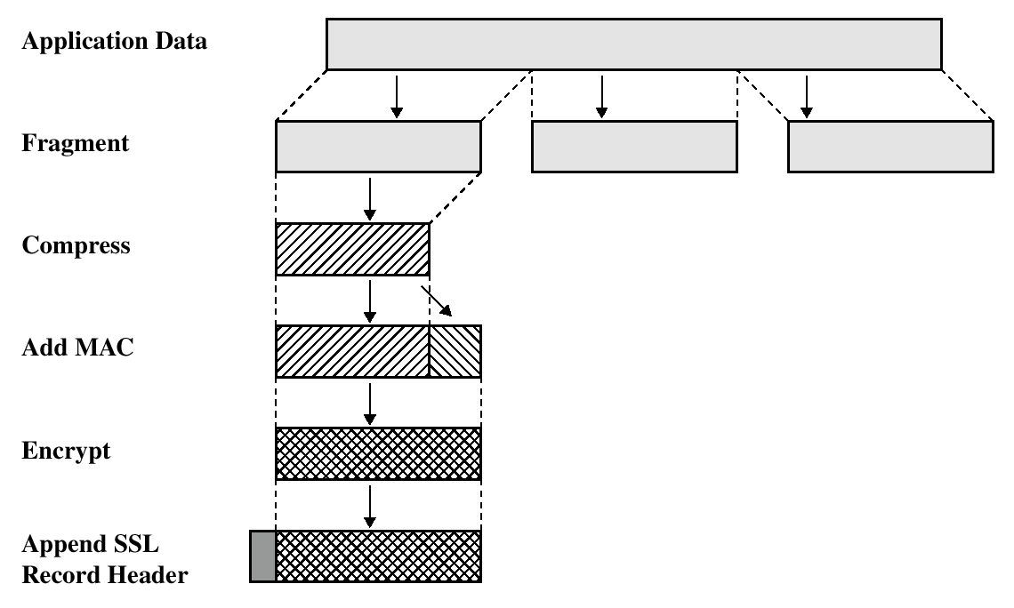
SSL/TLS Record Protection
Use symmetric keys established
in the handshake protocol
slide <number>

Slide 23
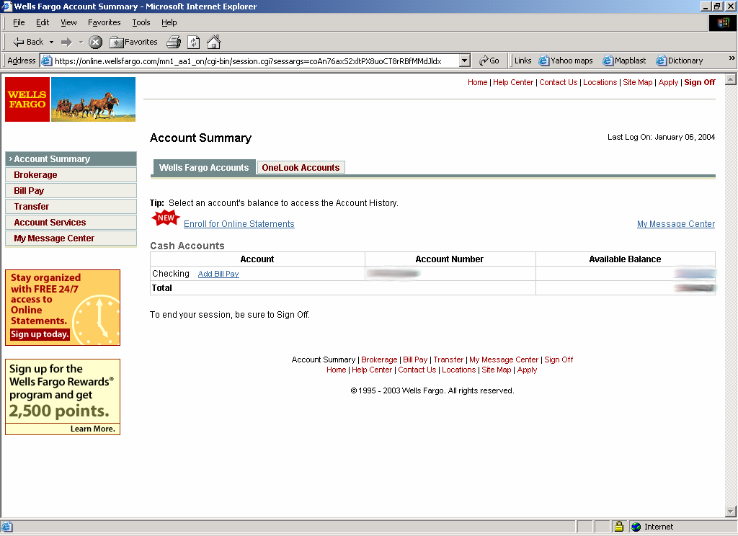
Most Common Use of SSL/TLS
slide <number>

Slide 24



HTTPS and Its Adversary Model
HTTPS: end-to-end secure protocol for Web
Designed to be secure against network attackers, including man-in-the-middle (MITM) attacks
HTTPS provides encryption, authentication (usually for server only), and integrity checking
browser
proxy
HTTPS server
Internet
HTTPS tunnel
slide <number>

Slide 25
The Lock Icon
Goal: identify secure connection
  SSL/TLS is being used between client and server to protect against active network attacker
Lock icon should only be shown when the page is secure against network attacker
  Semantics subtle and not widely understood by users
  Problem in user interface design
slide <number>

Slide 26
HTTPS Security Guarantees
The origin of the page is what it says in the address bar
  User must interpret what he sees - remember amazonaccounts.com?
Contents of the page have not been viewed or modified by a network attacker
slide <number>

Slide 27
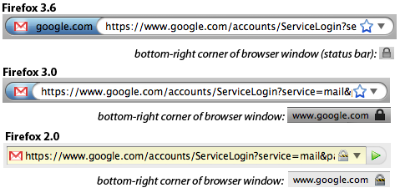
Evolution of the Lock in Firefox
[Schultze]
How about Firefox 4?
slide <number>

Slide 28
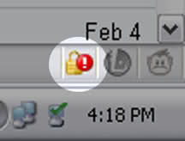
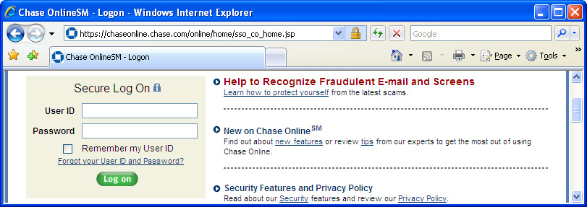
Combining HTTPS and HTTP
Page served over HTTPS but contains HTTP
  IE 7: no lock, “mixed content” warning
  Firefox: “!” over lock, no warning by default
  Safari: does not detect mixed content
  Flash does not trigger warning in IE7 and FF
Network attacker can now inject scripts, hijack session
Lock icon
Flash file served
over HTTP
Can script
embedding page!
slide <number>

Slide 29
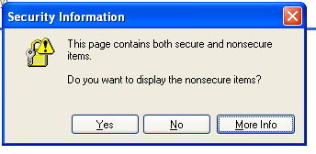
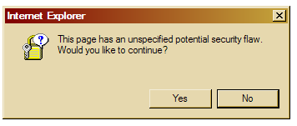
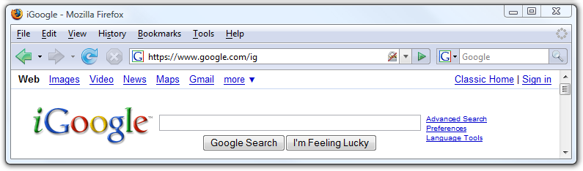
Mixed Content: UI Challenges
slide <number>

Slide 30
Mixed Content and Network Attacks
Banks: after login, all content served over HTTPS
Developer error: somewhere on bank site write
  <script src=http://www.site.com/script.js> </script>
  Active network attacker can now hijack any session (how?)
Better way to include content:
  <script src=//www.site.com/script.js> </script>
  Served over the same protocol as embedding page
slide <number>

Slide 31

HTTP → HTTPS and Back
Typical pattern: HTTPS upgrade
  Come to site over HTTP, redirect to HTTPS for login
  Browse site over HTTP, redirect to HTTPS for checkout
sslstrip: network attacker downgrades connection
  Rewrite <a href=https://…> to <a href=http://…>
  Redirect Location: https://... to Location: http://...
  Rewrite <form action=https://… >
  to <form action=http://…>
HTTP
SSL
attacker
Can the server detect
this attack?
slide <number>

Slide 32
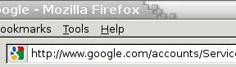
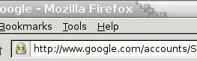
Will You Notice?
[Moxie Marlinspike]
⇒
Clever favicon inserted
by network attacker
slide <number>

Slide 33
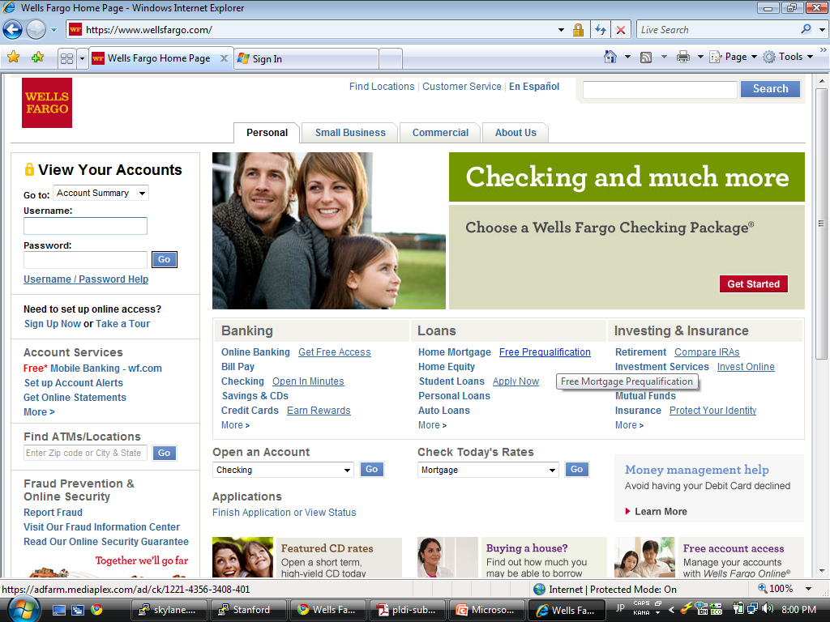

Motivation
https://
Whose public key is used to
establish the secure session?
slide <number>

Slide 34
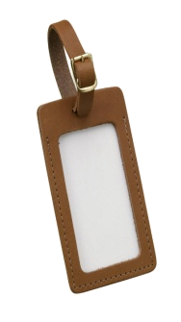


Authenticity of Public Keys
Bob’s key
?
private key
Bob
Alice
public key
Problem: How does Alice know that the public key
she received is really Bob’s public key?
slide <number>

Slide 35
Distribution of Public Keys
Public announcement or public directory
  Risks: forgery and tampering
Public-key certificate
  Signed statement specifying the key and identity
    sig_{Alice}(“Bob”, PK_{B})
Common approach: certificate authority (CA)
  An agency responsible for certifying public keys
  Browsers are pre-configured with 100+ of trusted CAs
  A public key for any website in the world will be accepted by the browser if certified by one of these CAs
slide <number>

Slide 36
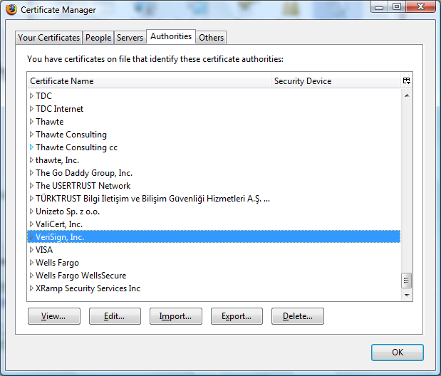
Trusted Certificate Authorities
slide <number>

Slide 37
CA Hierarchy
Browsers, operating systems, etc. have trusted root certificate authorities
  Firefox 3 includes certificates of 135 trusted root CAs
A Root CA signs certificates for intermediate CAs, they sign certificates for lower-level CAs, etc.
  Certificate “chain of trust”
    sig_{Verisign}(“UT Austin”, PK_{UT}), sig_{UT}(“Vitaly S.”, PK_{Vitaly})
CA is responsible for verifying the identities of certificate requestors, domain ownership
slide <number>

Slide 38
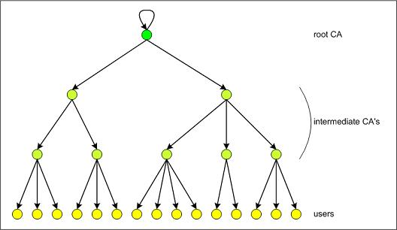
Certificate Hierarchy
What power do they have?
Who trusts their certificates?
slide <number>

Slide 39
Alternative: “Web of Trust”
Used in PGP (Pretty Good Privacy)
Instead of a single root certificate authority, each person has a set of keys they “trust”
  If public-key certificate is signed by one of the “trusted” keys, the public key contained in it will be deemed valid
Trust can be transitive
  Can use certified keys for further certification
I trust
Alice
sig_{Alice}(“Friend”, Friend’s key)
sig_{Friend}(“FoaF”, FoaF’s key)
Friend of Alice
Bob
Alice
Friend of friend
slide <number>

Slide 40
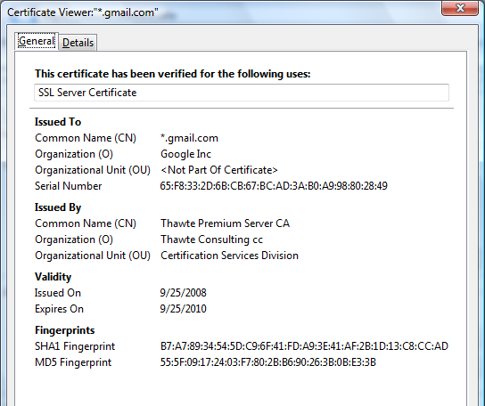
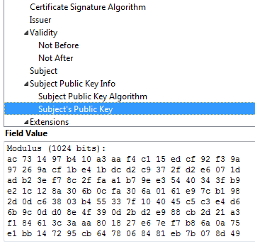
Example of a Certificate
Important fields
slide <number>

Slide 41
Common Name
Explicit name: www.foo.com
Wildcard: *.foo.com or www*.foo.com
Matching rules
  Firefox 3: * matches anything
  Internet Explorer 7: * must occur in the leftmost component, does not match ‘.’
    *.foo.com matches a.foo.com, but not a.b.foo.com
slide <number>

Slide 42
International Domain Names
Rendered using international character set
Chinese character set contains characters that look like / ? = .
  What could go wrong?
Can buy a certificate for *.foo.cn, create any number of domain names that look like
www.bank.com/accounts/login.php?q=me.foo.cn
  What does the user see?
  *.foo.cn certificate works for all of them!
slide <number>

Slide 43
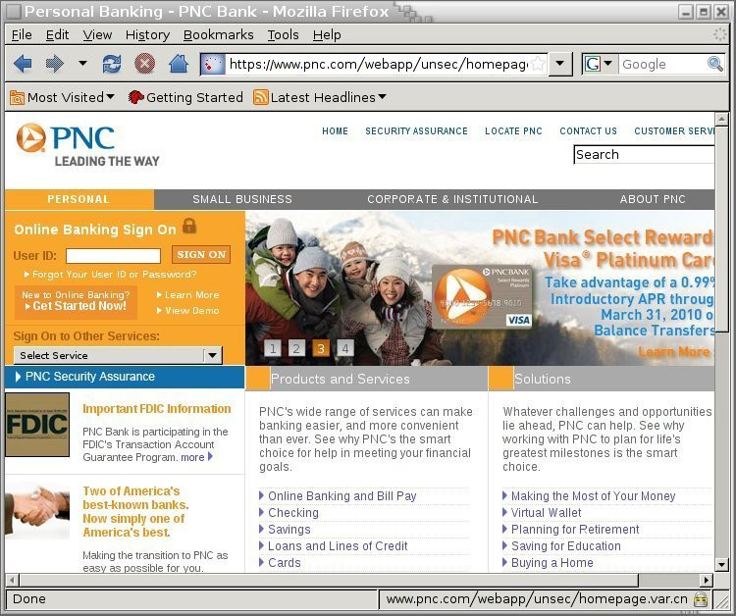
Example
[Moxie Marlinspike]
slide <number>

Slide 44
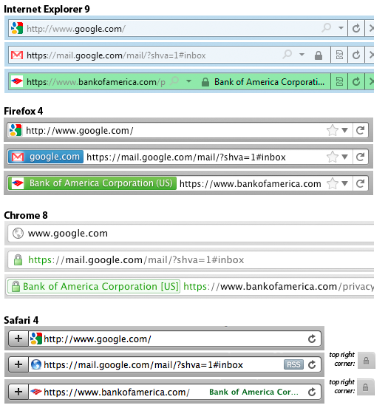
Meaning of Color
[Schultze]
What is the difference?
Domain Validation (DV)
certificate
vs.
Extended Validation (EV)
certificate
Means what?
slide <number>

Slide 45
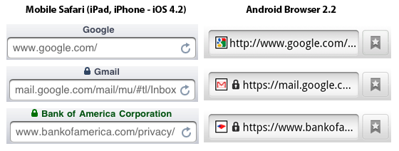
Mobile Browsing
[Schultze]
Same lock for DV and EV
Windows Phone 7: same behavior
… but only when URL bar present
… landscape mode: no URL bar
http://www.freedom-to-tinker.com/blog/sjs/web-browser-security-user-interfaces-hard-get-right-and-increasingly-inconsistent
slide <number>

Slide 46
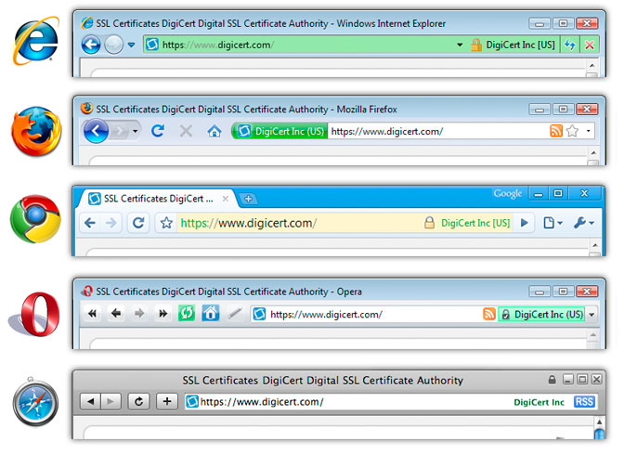
Extended Validation (EV) Certificates
Certificate request must be approved by a human lawyer at the certificate authority
slide <number>

Slide 47
Questions about EV Certificates
What does EV certificate mean?
What is the difference between an HTTPS connection that uses a regular certificate and an HTTPS connection that uses an EV certificate?
If an attacker has somehow obtained a non-EV certificate for bank.com, can he inject a script into https://bank.com content?
  What is the origin of the script? Can it access or modify content that arrived from actual bank.com via HTTPS?
What would the browser show – blue or green?
slide <number>

Slide 48
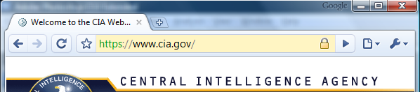
When Should The Lock Be Shown?
All elements on the page fetched using HTTPS
For all elements:
HTTPS certificate is issued by a certificate authority (CA) trusted by the browser
HTTPS certificate is valid – means what?
Common Name in the certificate matches domain name in the URL
slide <number>

Slide 49
X.509 Authentication Service
Internet standard (1988-2000)
Specifies certificate format
  X.509 certificates are used in IPsec and SSL/TLS
Specifies certificate directory service
  For retrieving other users’ CA-certified public keys
Specifies a set of authentication protocols
  For proving identity using public-key signatures
Can use with any digital signature scheme and hash function, but must hash before signing
Remember MD5?
slide <number>

Slide 50
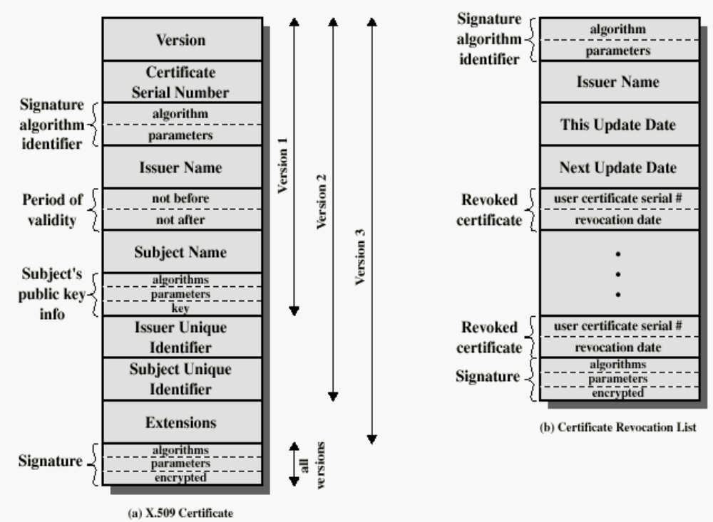
X.509 Certificate
Added in X.509 versions 2 and 3 to address
usability and security problems
hash
slide <number>

Slide 51
Back in 2008
[Sotirov et al. “Rogue Certificates”]
Many CAs still used MD5
  RapidSSL, FreeSSL, TrustCenter, RSA Data Security, Thawte, verisign.co.jp
Sotirov et al. collected 30,000 website certificates
9,000 of them were signed using MD5 hash
97% of those were issued by RapidSSL
slide <number>

Slide 52
Colliding Certificates
[Sotirov et al. “Rogue Certificates”]
serial number
serial number
set by
the CA
validity period
validity period
chosen prefix
(difference)
real cert
domain name
rogue cert
domain name
real cert
RSA key
???
Hash to the same
MD5 value!
collision bits
(computed)
Valid for both certificates!
X.509 extensions
X.509 extensions
identical bytes
(copied from real cert)
signature
signature
slide <number>

Slide 53
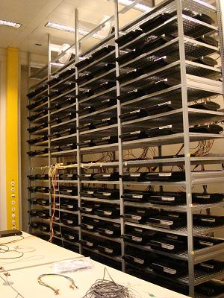
Generating Collisions
[Sotirov et al. “Rogue Certificates”]
1-2 days on a cluster of 200 PlayStation 3’s
Equivalent to 8000 desktop CPU cores or $20,000 on Amazon EC2
slide <number>

Slide 54
Generating Colliding Certificates
[Sotirov et al. “Rogue Certificates”]
RapidSSL uses a fully automated system
  $69 for a certificate, issued in 6 seconds
  Sequential serial numbers
Technique for generating colliding certificates
  Get a certificate with serial number S
  Predict time T when RapidSSL’s counter goes to S+1000
  Generate the collision part of the certificate
  Shortly before time T buy enough (non-colliding) certificates to increment the counter to S+999
  Send colliding request at time T and get serial number S+1000
slide <number>

Slide 55
Creating a Fake Intermediate CA
[Sotirov et al. “Rogue Certificates”]
serial number
rogue CA cert
validity period
real cert domain
name
chosen prefix
(difference)
rogue CA RSA key
rogue CA X.509
extensions
CA bit!
real cert
RSA key
Netscape Comment
Extension
(contents ignored by
browsers)
We are now an
intermediate CA.
W00T!
collision bits
(computed)
X.509 extensions
identical bytes
(copied from real cert)
signature
signature
slide <number>

Slide 56
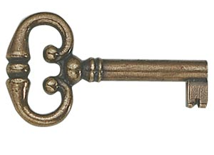
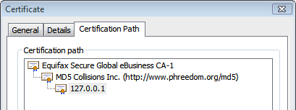
Result: Perfect Man-in-the-Middle
[Sotirov et al. “Rogue Certificates”]
This is a “skeleton key” certificate: it can issue fully trusted certificates for any site (why?)
To take advantage, need a network attack
  Insecure wireless, DNS poisoning, proxy auto-discovery, hacked routers, etc.
slide <number>

Slide 57
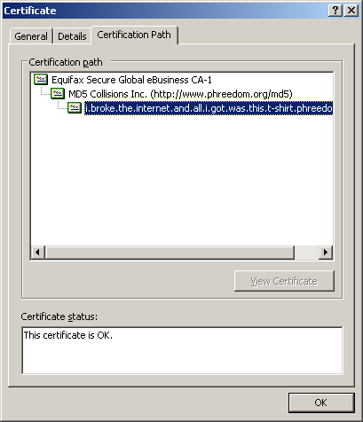
A Rogue Certificate
slide <number>

Slide 58
Remember Flame?
Cyber-espionage virus (2010-2012)
Signed with a fake intermediate CA certificate that appears to be issued by Microsoft and thus accepted by any Windows Update service
  Fake intermediate CA certificate was created using an MD5 chosen-prefix collision against an obscure Microsoft Terminal Server Licensing Service certificate that was enabled for code signing and still used MD5
MD5 collision technique possibly pre-dates Sotirov et al.’s work
  Evidence of state-level cryptanalysis?
slide <number>

Slide 59

SSL/TLS Handshake
Hello
C
S
Here is my certificate
Validate
the certificate
slide <number>

Slide 60
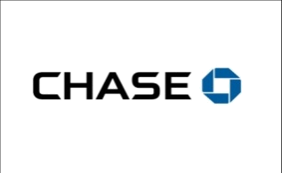

SSL/TLS Handshake
Hello
Android
app
I am Chase.com
Here is my certificate
Issued by GoDaddy to
AllYourSSLAreBelongTo.us
Ok!
slide <number>

Slide 61

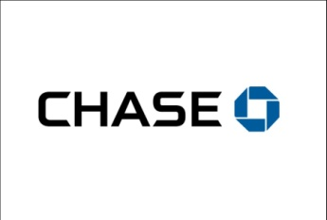
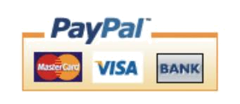

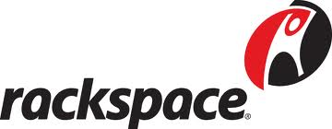
Failing to Check Hostname
“Researchers at the University of Texas at Austin and Stanford University have discovered that poorly designed APIs used in SSL implementations are to blame for vulnerabilities in many critical non-browser software packages. Serious security vulnerabilities were found in programs such as Amazon’s EC2 Java library, Amazon’s and PayPal’s merchant SDKs, Trillian and AIM instant messaging software, popular integrated shopping cart software packages, Chase mobile banking software, and several Android applications and libraries. SSL connections from these programs and many others are vulnerable to a man in the middle attack…”
- Threatpost (Oct 2012)
Major payment processing gateways,
client software for cloud computing,
integrated e-commerce software, etc.
slide <number>

Slide 62

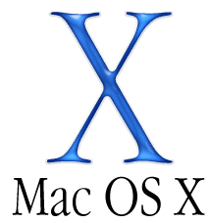
What Happens After Validation?
Hello
I am PayPal.com
(or whoever you want me to be)
Here is PayPal’s certificate for
its RSA signing key
And here is my signed Diffie-Hellman value
Validate the certificate
… then verify the signature on the DH value using the public key from the certificate
slide <number>

Slide 63
Goto Fail
Here is PayPal’s certificate
And here is my signed Diffie-Hellman value
… verify the signature on the DH value using the public key from the certificate
if ((err = SSLHashSHA1.update(&hashCtx, &clientRandom)) != 0)
goto fail;
if ((err = SSLHashSHA1.update(&hashCtx, &serverRandom)) != 0)
goto fail;
if ((err = SSLHashSHA1.update(&hashCtx, &signedParams)) != 0)
goto fail;
goto fail;
if ((err = SSLHashSHA1.final(&hashCtx, &hashOut)) != 0)
goto fail; …
err = sslRawVerify(...);
…
fail: … return err …
???
Signature is verified here
slide <number>

Slide 64
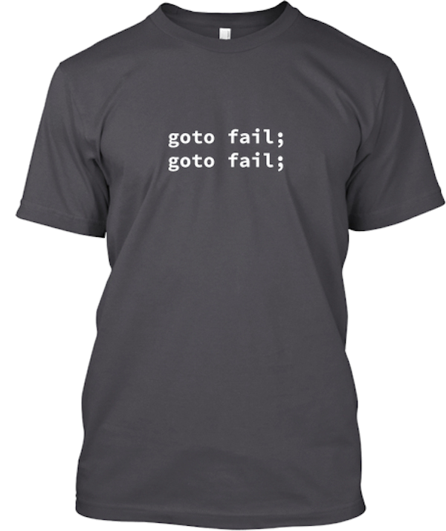
Complete Fail Against MITM
Discovered in February 2014
All OS X and iOS software vulnerable to man-in-the-middle attacks
  Broken TLS implementation provides no protection against the very attack it was supposed to prevent
What does this tell you about quality control for security-critical software?
slide <number>

Slide 65
Certificate Revocation
Revocation is very important
Many valid reasons to revoke a certificate
  Private key corresponding to the certified public key has been compromised
  User stopped paying his certification fee to the CA and the CA no longer wishes to certify him
  CA’s certificate has been compromised!
Expiration is a form of revocation, too
  Many deployed systems don’t bother with revocation
  Re-issuance of certificates is a big revenue source for certificate authorities
slide <number>

Slide 66
Certificate Revocation Mechanisms
Online revocation service
  When a certificate is presented, recipient goes to a special online service to verify whether it is still valid
Certificate revocation list (CRL)
  CA periodically issues a signed list of revoked certificates
  Can issue a “delta CRL” containing only updates
Q: Does revocation protect against forged
certificates?
slide <number>

Slide 67
X.509 Certificate Revocation List
Because certificate serial numbers
must be unique within each CA, this is
enough to identify the certificate
hash
slide <number>

Slide 68
Some Questions About Certificates
How do CAs verify identities of domains to whom they issue certificates (domain validation)?
Does your browser check whether the site’s certificate has been revoked?
What do you do when your browser warns you that the site’s certificate has expired?
  Most users click through, enter credentials
Over 40% of certs are self-signed – means what?
slide <number>

Slide 69
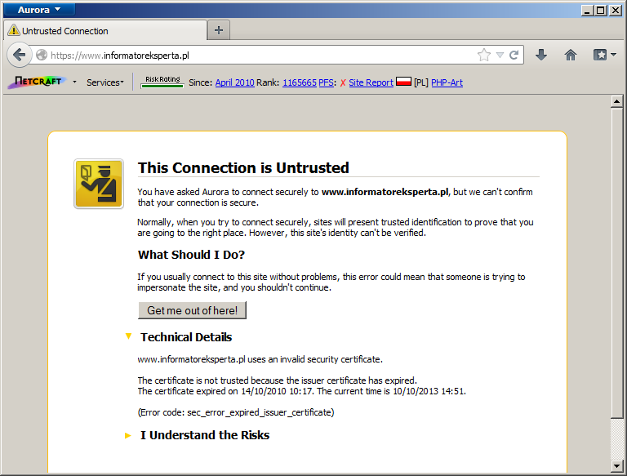
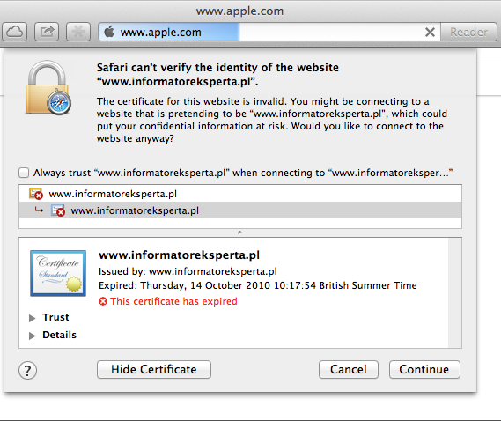
Invalid Certificate Warnings
http://news.netcraft.com/archives/2013/10/16/us-government-aiding-spying-against-itself.html
slide <number>

Slide 70

Comodo
Comodo is one of the trusted root CAs
  Its certificates for any website in the world are accepted by every browser
Comodo accepts certificate orders submitted through resellers
  Reseller uses a program to authenticate to Comodo and submit an order with a domain name and public key, Comodo automatically issues a certificate for this site
slide <number>

Slide 71
Comodo Break-In
An Iranian hacker broke into instantSSL.it and globalTrust.it resellers, decompiled their certificate issuance program, learned the credentials of their reseller account and how to use Comodo API
  username: gtadmin, password: globaltrust
Wrote his own program for submitting orders and obtaining Comodo certificates
On March 15, 2011, got Comodo to issue 9 rogue certificates for popular sites
  mail.google.com, login.live.com, login.yahoo.com, login.skype.com, addons.mozilla.org, “global trustee"
slide <number>

Slide 72
Consequences
Attacker needs to first divert users to an attacker-controlled site instead of Google, Yahoo, Skype, but then…
  For example, use DNS to poison the mapping of mail.yahoo.com to an IP address
… “authenticate” as the real site
… decrypt all data sent by users
  Email, phone conversations, Web browsing
Q: Does HTTPS help? How about EV certificates?
slide <number>

Slide 73
Message from the Attacker
http://pastebin.com/74KXCaEZ
I'm single hacker with experience of 1000 hacker, I'm single programmer with experience of 1000 programmer, I'm single planner/project manager with experience of 1000 project managers …
When USA and Isarel could read my emails in Yahoo, Hotmail, Skype, Gmail, etc. without any simple little problem, when they can spy using Echelon, I can do anything I can. It's a simple rule. You do, I do, that's all. You stop, I stop. It's rule #1 …
Rule#2: So why all the world got worried, internet shocked and all writers write about it, but nobody writes about Stuxnet anymore?... So nobody should write about SSL certificates.
Rule#3: I won't let anyone inside Iran, harm people of Iran, harm my country's Nuclear Scientists, harm my Leader (which nobody can), harm my President, as I live, you won't be able to do so. as I live, you don't have privacy in internet, you don't have security in digital world, just wait and see...
slide <number>

Slide 74

DigiNotar Break-In
In June 2011, the same “ComodoHacker” broke into a Dutch certificate authority, DigiNotar
  Message found in scripts used to generate fake certificates:
  “THERE IS NO ANY HARDWARE OR SOFTWARE IN THIS WORLD EXISTS WHICH COULD STOP MY HEAVY ATTACKS MY BRAIN OR MY SKILLS OR MY WILL OR MY EXPERTISE"
Security of DigiNotar servers
  All core certificate servers in a single Windows domain, controlled by a single admin password (Pr0d@dm1n)
  Software on public-facing servers out of date, unpatched
  Tools used in the attack would have been easily detected by an antivirus… if it had been present
slide <number>

Slide 75
Consequences of DigiNotar Hack
Break-in not detected for a month
Rogue certificates issued for *.google.com, Skype, Facebook, www.cia.gov, and 527 other domains
99% of revocation lookups for these certificates originated from Iran
  Evidence that rogue certificates were being used, most likely by Iranian government or Iranian ISPs to intercept encrypted communications
    Textbook man-in-the-middle attack
  300,000 users were served rogue certificates
slide <number>

Slide 76
Another Message from the Attacker
http://pastebin.com/u/ComodoHacker
Most sophisticated hack of all time … I’m really sharp, powerful, dangerous and smart!
My country should have control over Google, Skype, Yahoo, etc. […] I’m breaking all encryption algorithms and giving power to my country to control all of them.
You only heards Comodo (successfully issued 9 certs for me -thanks by the way-), DigiNotar (successfully generated 500+ code signing and SSL certs for me -thanks again-), StartCOM (got connection to HSM, was generating for twitter, google, etc. CEO was lucky enough, but I have ALL emails, database backups, customer data which I'll publish all via cryptome in near future), GlobalSign (I have access to their entire server, got DB backups, their linux / tar gzipped and downloaded, I even have private key of their OWN globalsign.com domain, hahahaa).... BUT YOU HAVE TO HEAR SO MUCH MORE! SO MUCH MORE! At least 3 more, AT LEAST!
slide <number>

Slide 77

TrustWave
In Feb 2012, admitted issuance of an intermediate CA certificate to a corporate customer
  Purpose: “re-sign” certificates for “data loss prevention”
  Translation: forge certificates of third-party sites in order to spy on employees’ encrypted communications with the outside world
Customer can now forge certificates for any site in world… and they will be accepted by any browser!
  What if a “re-signed” certificate leaks out?
Do other CAs do this?
slide <number>

Slide 78

TurkTrust
In Jan 2013, a rogue *.google.com
certificate was issued by an intermediate
CA that gained its authority from the Turkish
root CA TurkTrust
  TurkTrust accidentally issued intermediate CA certs to customers who requested regular certificates
  Ankara transit authority used its certificate to issue a fake *.google.com certificate in order to filter SSL traffic from its network
This rogue *.google.com certificate was trusted by every browser in the world
slide <number>

